Slide 1

Front End Web Development
Training Program
www.acadgild.com

Slide 2
What is Front End Web Development?
Front-end web development, also known as client-side development is the practice of producing HTML, CSS and JavaScript for a website or web application so that a user can see and interact with them directly.
www.acadgild.com

Slide 3
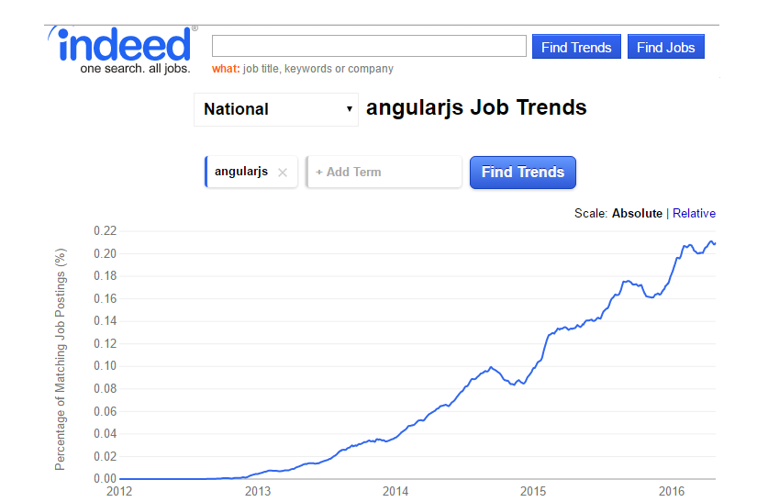
Why Learn Front End Web Development - AngularJS?
www.acadgild.com

Slide 4
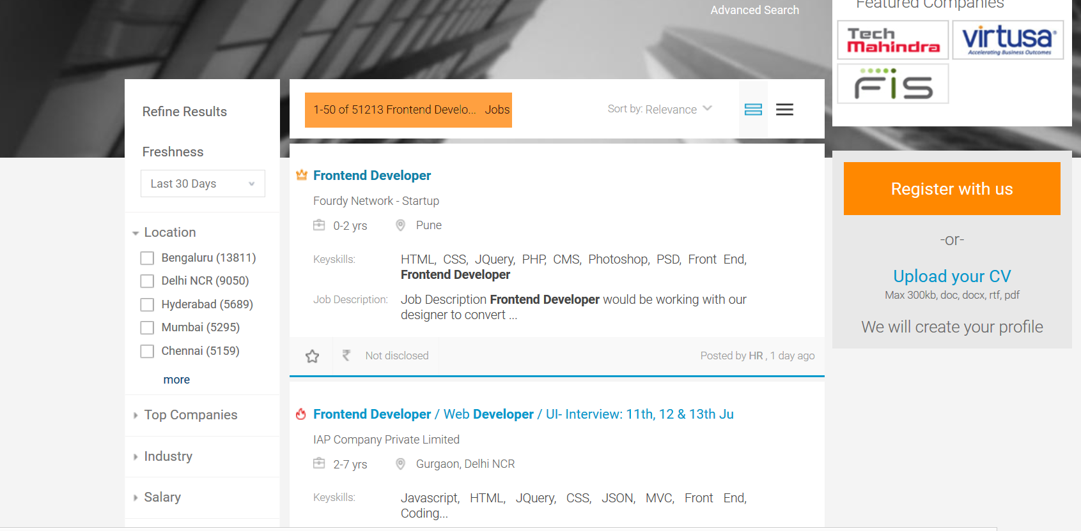
Why Learn Front End Web Development - AngularJS?
www.acadgild.com

Slide 5

To Become Expert in Front End Web Development
Get the skills to build engaging, interactive user experiences on the web
Fundamentals
HTML
CSS
CSS 3
Java Script
Advanced
Advanced JS
JQuery
Bootstrap
AngularJS
www.acadgild.com

Slide 6
Real Time Hands-on Experience
Each session will consist of 4 assignments
Due by next session
Course will end with a Real time project
Demonstrate skills in all the modules
Build 2 Real Time Projects
AngularJS
Bootstrap
jQuery
Java Script
CSS and CSS 3
HTML and WWW
www.acadgild.com

Slide 7
Fundamentals – Module 1
Fundamentals will start with introduction to HTML
Client – server
Skills Acquired
Knowledge of Web
HTML basics
Understanding URL
Web Request Cycle
Server vs Client side languages
How to code HTML?
Tags and Syntax
Doctype
Name servers
How web works?
www.acadgild.com

Slide 8
Fundamentals – Module 2
After assessing HTML basics, the next module on HTML Advanced will be covered.
HTML – Advanced
Designing Forms
Lists
Tables
Images
Using iFrames
Other useful Tags
Skills Acquired
Using Forms
Tags and attributes
Embedding web pages using iFrames
www.acadgild.com

Slide 9
Fundamentals – Module 3
Developing Web page layouts is followed by Styling them using CSS.
Understanding CSS
Syntax
Selectors and Types
Attribute Selectors
Attaching CSS
Display Property
CSS Box Model
Margin
Links and CSS Units
Position Property
Float and its problems
Inheritance and Specificity
Media Queries
CSS Expert
www.acadgild.com

Slide 10
Fundamentals – Module 4
If CSS gives you the ability to style Web Pages, CSS 3 takes this to the next level
CSS 3
Transitions
Animations
Gradients
Filters
Multi Column Layouts
Box Model
Flex Property
Selectors and Pseudo Classes
Text Shadow
Develop interactive and responsive web pages
www.acadgild.com

Slide 11
Fundamentals – Module 5
Layout and Styling are of no use without dynamic interactivity on Websites
JavaScript
What is JavaScript?
Writing first program
Using Browser Console
Data types
Examples of Data Types
Dev Tools
Operators
Functions - Basics
www.acadgild.com

Slide 12
Fundamentals – Module 6
Conditions and iterations are an integral part of a programming language, and so for JavaScript
JavaScript - 2
Conditionals
If, If/Else, Else-if, Switch
Iteration/loops
While
Functions
Scope
Do-while
For and For-In
Arguments (Unnamed)
www.acadgild.com

Slide 13
Fundamentals – Module 7
Handling user events using JavaScript.
JavaScript - 3
DOM
DOM Manipulation
Event
Form Validation
Types of Events
www.acadgild.com

Slide 14
Fundamentals – Module 8
Dependency on plugins has made web development difficult – HTML 5 APIs solves this problem
HTML 5
What is HTML 5
Semantic Tags
HTML 5 Form API
Storage API
Geolocation API
Media API
Browser Support
www.acadgild.com

Slide 15
Advance JavaScript
Learning JavaScript is incomplete without exploring the Object Oriented Features of JS.
What is Object Oriented Programming
Inner functions and Closures
Creating Objects
Inheritance
www.acadgild.com

Slide 16
jQuery
Implementing cross browser logic is tedious and often difficult to test.
Using jQuery will reduce the risk as it supports most of the latest browsers
Setting up jQuery
Using Selectors
DOM Manipulation
Traversing parent, sibling and children
Event handling
AJAX and Promise API
www.acadgild.com

Slide 17
Bootstrap
CSS could get easier if everything is already in place and just add the classes.
Setting up and customizing Bootstrap
Containers
Images and Tables
Typography
Forms and Inputs
Panels
What is going be new in Bootstrap 4.0
www.acadgild.com

Slide 18
AngularJS
Libraries are not enough for high-end web applications
Sometimes MVC solves most of the problems
AngularJS turns out to be the leader in MVC in JS
And Yes, its not a library, rather a framework
www.acadgild.com

Slide 19
AngularJS
Why use AngularJS?
What is MVC (MV*)
What is SPA?
Features of AngularJS
Modules
Data Binding
Directives and Scopes
Filters
Dependency Injection
Custom Directives
HTTP API
Caching
Testing of AngularJS App
What is Unit testing?
Setting up Jasmine
Writing Test cases
Test Suite
End-to-end testing
Setting up Protractor
Using Angular-seed
Running tests using Karma
www.acadgild.com

Slide 20
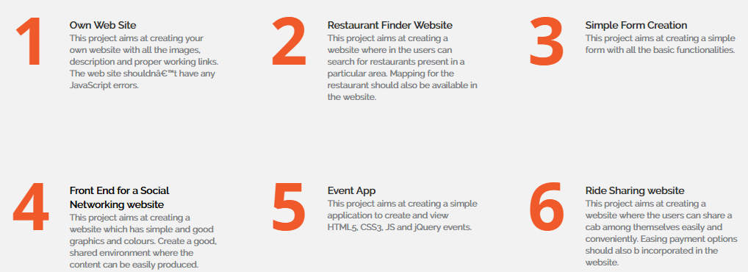
Develop Any 2 Apps
You have your own Idea! Great we will help you to build it…
www.acadgild.com

Slide 21

Land a Job in Front End Web Development
www.acadgild.com

Slide 22
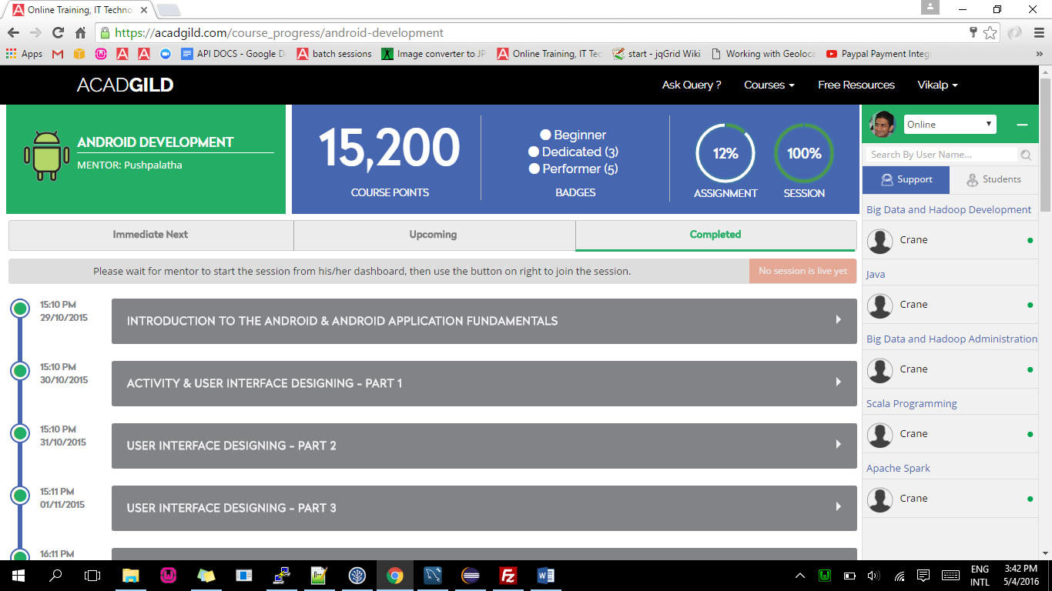
Our Platform
www.acadgild.com

Slide 23
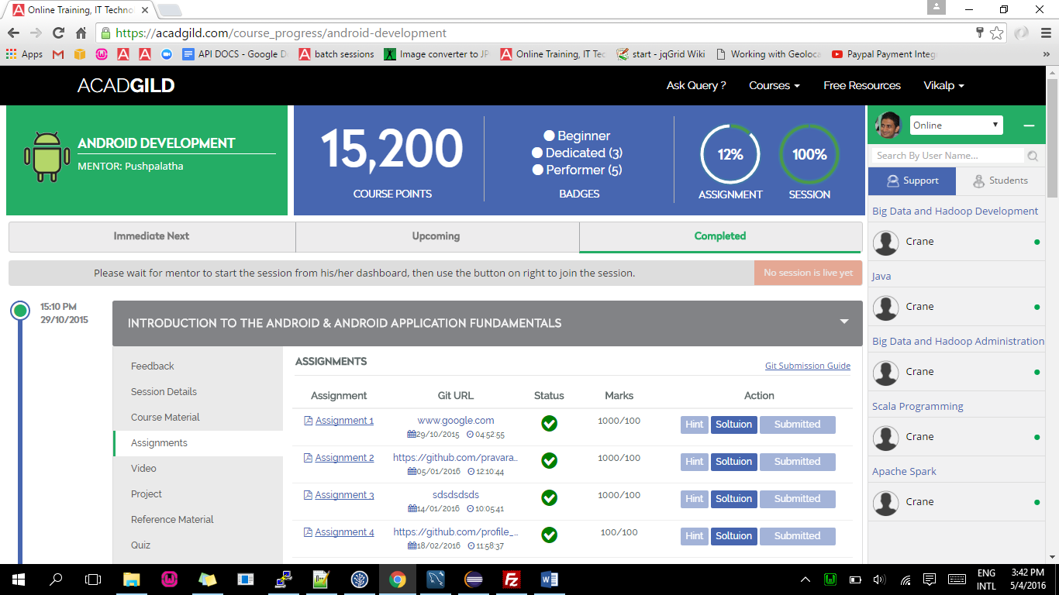
Our Platform - Assignments
www.acadgild.com

Slide 24
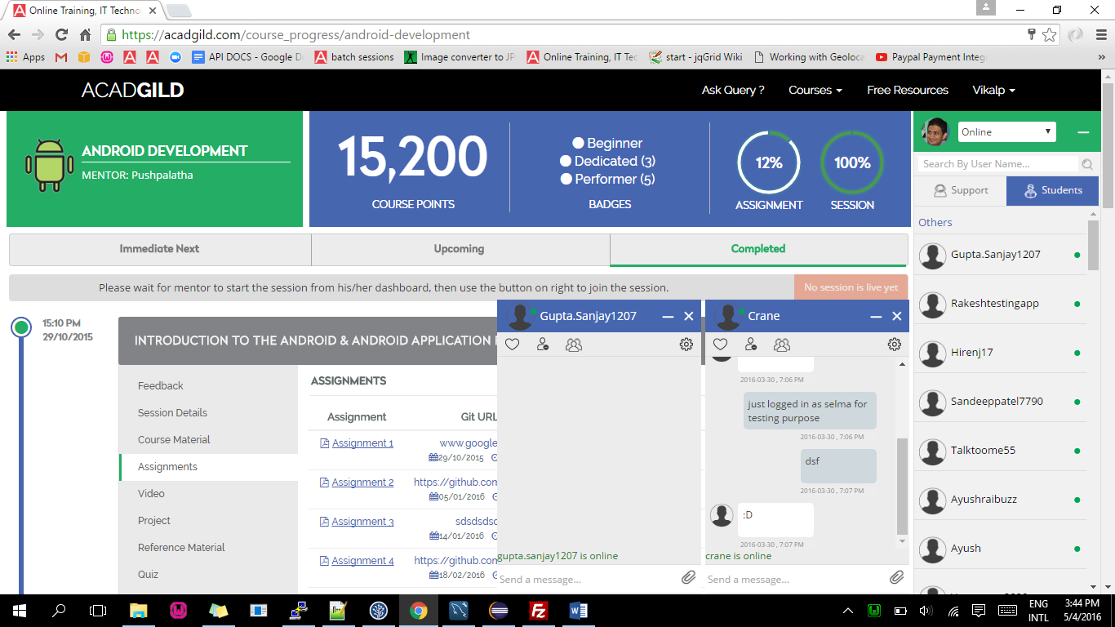
Our Platform -Chat
www.acadgild.com

Slide 25
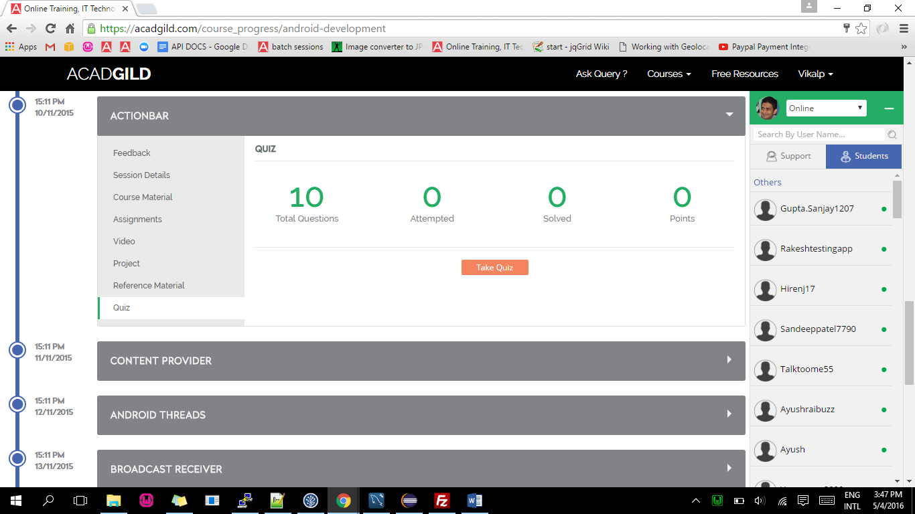
Our Platform - Quiz
www.acadgild.com

Slide 26
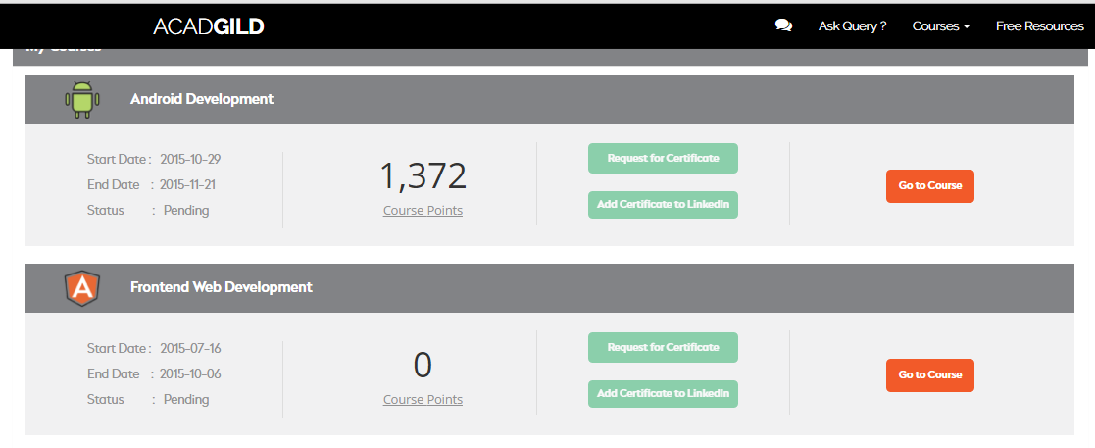
Our Platform – Certificate
www.acadgild.com

Slide 27
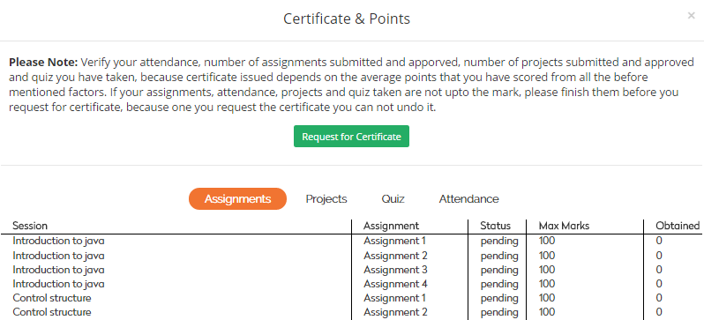
Our Platform – Certificate & Points
www.acadgild.com

Slide 28
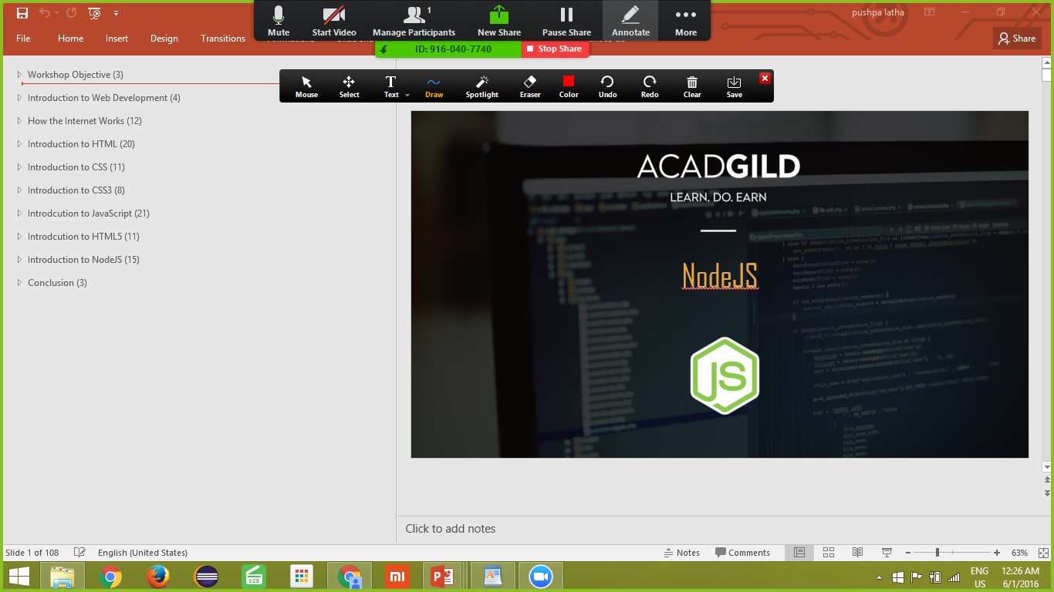
Our Platform – Meeting Tool
www.acadgild.com

Slide 29







Our Flagship Training Programs
We provide training based on modern cognitive methods of learning.
‘
Tell me and I forget, teach me and I may remember, involve me and I learn
Covering the latest technologies:
- Benjamin Franklin
Android
Web Development
Full Stack Dev
Software development requires highly specialized skills.
It is best learned with direct guidance from experienced practitioners.
Big Data
Analytics
Digital Marketing
AcadGild’s entire learning process is based on ‘doing’ rather than listening, reading or watching videos.
www.acadgild.com

Slide 30
Your Learning Starts Here
http://www.acadgild.com
For any clarifications, please contact:
(+91) 8880025025
support@acadgild.com
www.acadgild.com

